Slide 1

VIVO for Food Security & Innovation in Agriculture
Federico Sancho & Manuel Hidalgo
Inter American Institute for Cooperation in Agriculture
Austin VIVO Conference, August, 2014

Slide 2
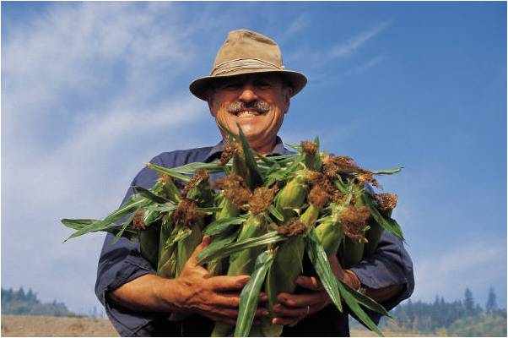
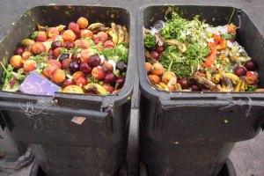
HOUSTON….WE HAVE A PROBLEM
To double production with half the resources…
or/and
To reduce 30% of food loss and improve distribution/consumption of food worldwide…
Source: Flickr/superk8nyc. Creative Commons

Slide 3
IICA & the Americas
Founded in 1942 as the specialized agency of the Inter American system for the development of agriculture and rural development
Headquarters in Costa Rica and offices in 34 member countries
Since 1943, IICA has been resourceful to member states in the provision of information services:
Authomatization of library catalogs
Web visibility of content
Virtual reference desk services
Country and regional networking (AGNIC-USA, REMBA-Mexico, RENIDA-Nicaragua, SIDALC-Argentina, among others)

Slide 4
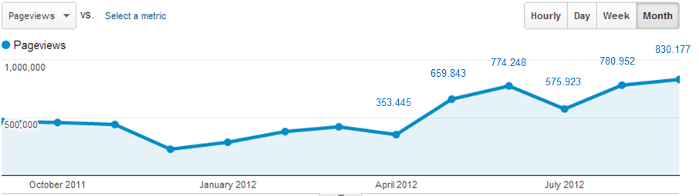

IICA & the Americas
IICA promotes one of the largest network of information sharing for agriculture around the globe
23 countries involved
172 institutions (Ministry of Agriculture, Universities, Research Institutes, among others)
2.6 millions references
+/- 275.000 full text records
10 KM and IM courses available online at www.imarkgroup.org
www.sidalc.net

Slide 5
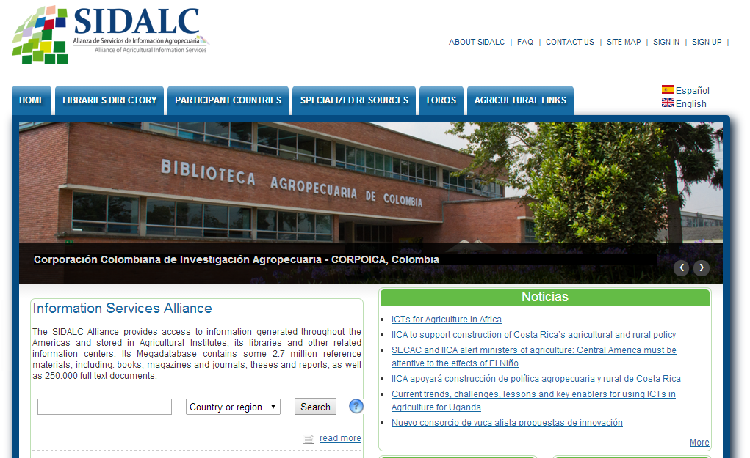

Slide 6
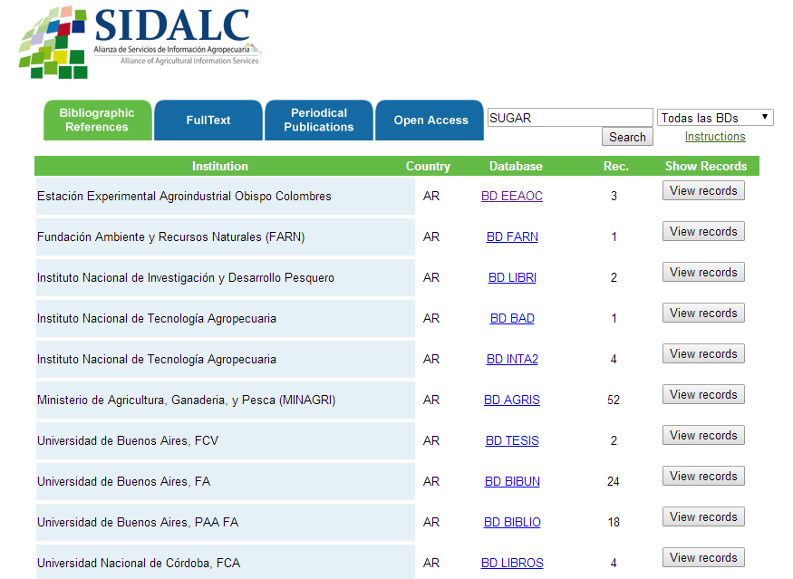
Full text

Slide 7
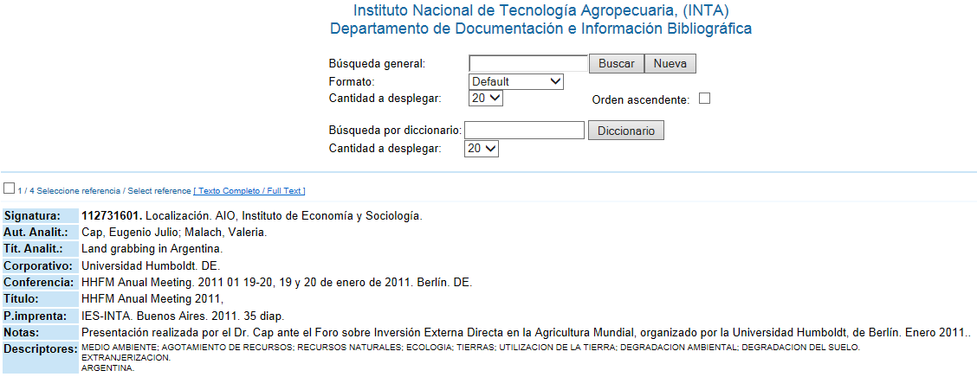
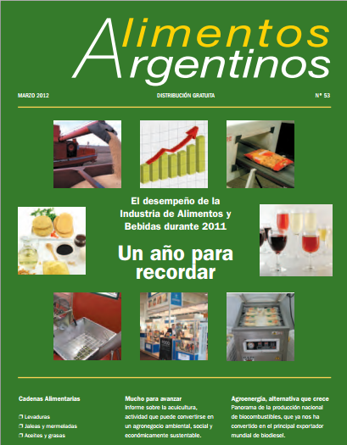

Slide 8
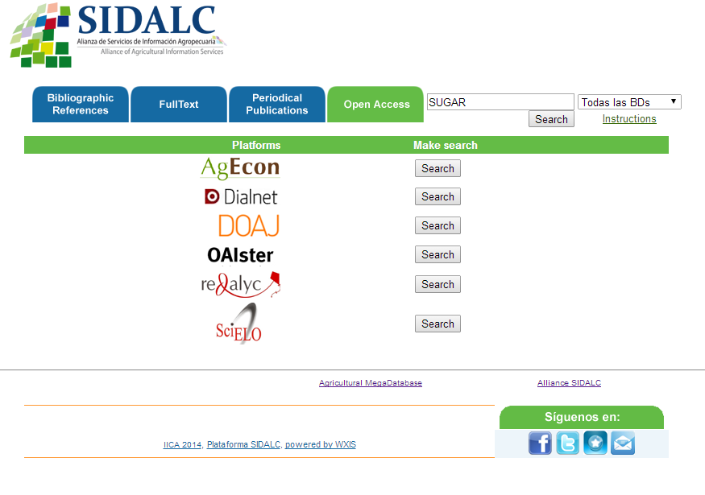

Slide 9
The next natural step
Promoting and using vivo

Slide 10
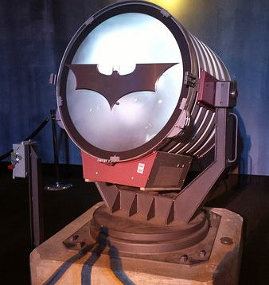
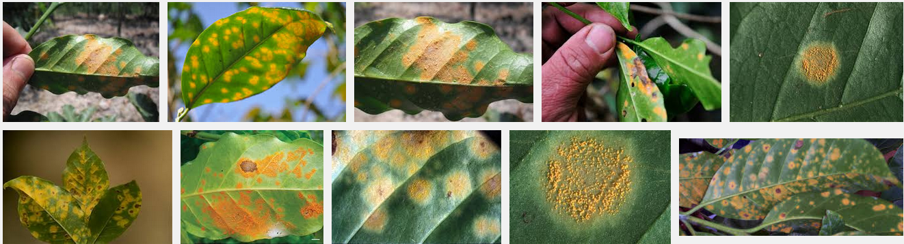
MOST OF US LIKE COFFEE…
2012-12-14-0473 by Al Pavangkanan from Flickr (Creative Commons License
Call the coffee experts….
15-56% of production reduction for Central America- Coffee Rust Summit, 2013

Slide 11
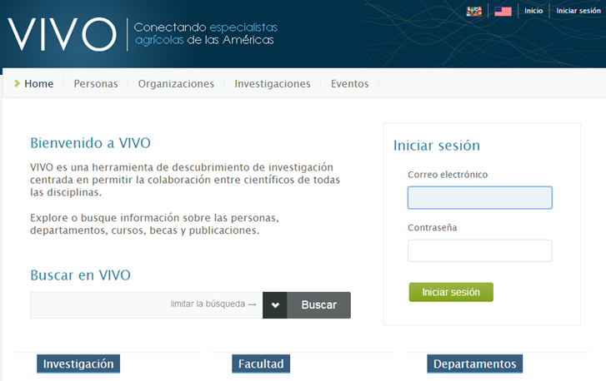
A recent joint collaboration VIVO IN SPANISH
VIVO as the solution to manage “tacit knowledge” in agriculture (2009)
USDA-CORNELL-IICA Project to adapt VIVO into Spanish (2013)
Now available at: https://wiki.duraspace.org/pages/viewpage.action?pageId=34662505.

Slide 12
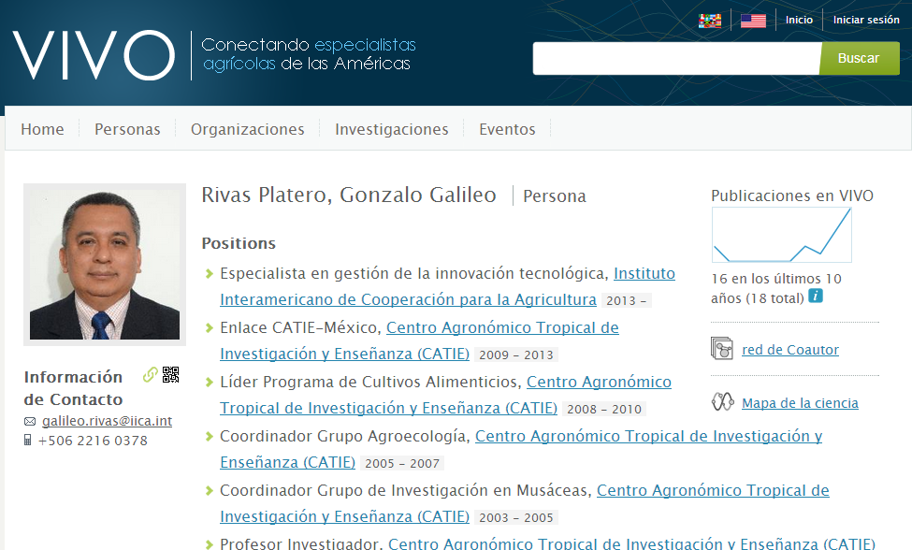

Slide 13
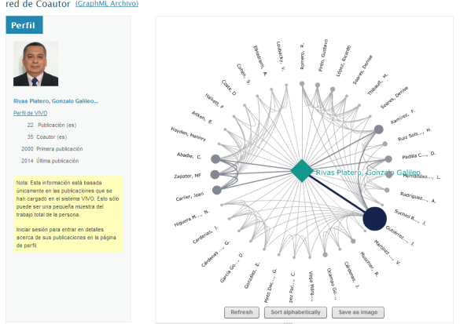
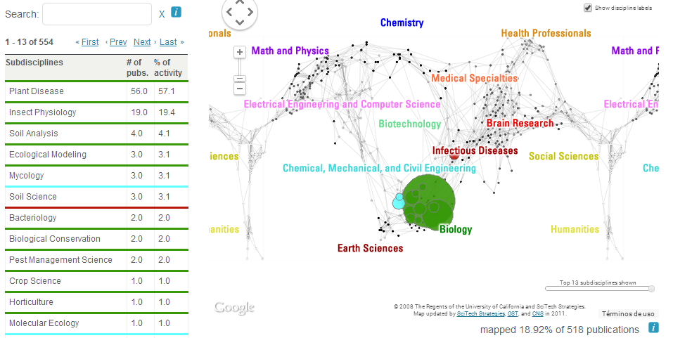

Slide 14
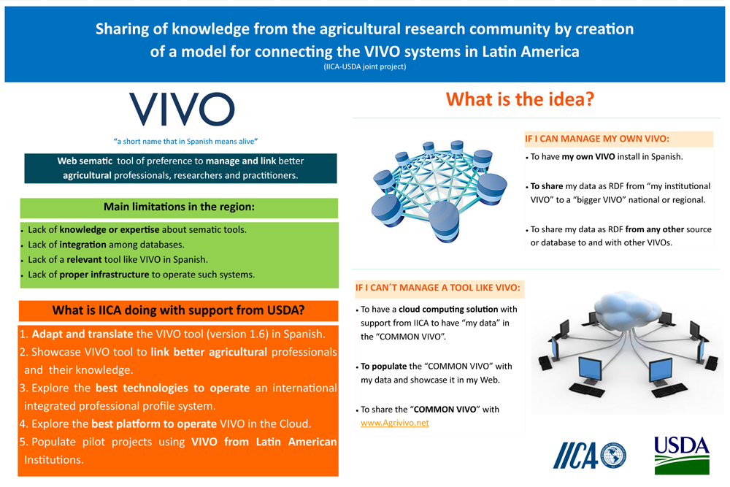
VIVO 4 food security

Slide 15
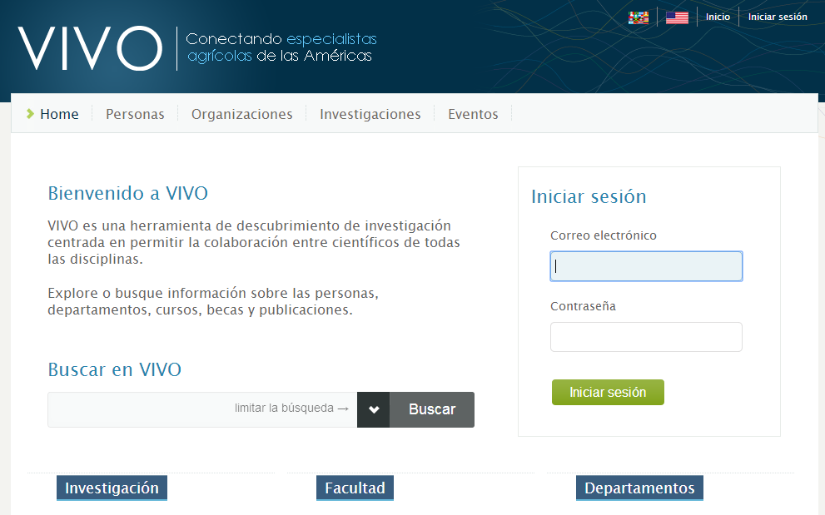
A common space-vivo in the cloud
One VIVO for all….

Slide 16
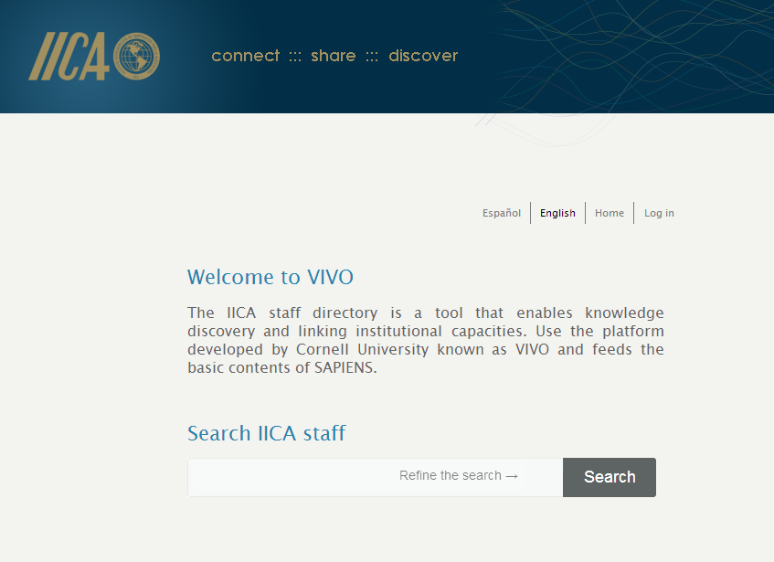
A common space-vivo in the cloud
One VIVO for all….with a different search box

Slide 17
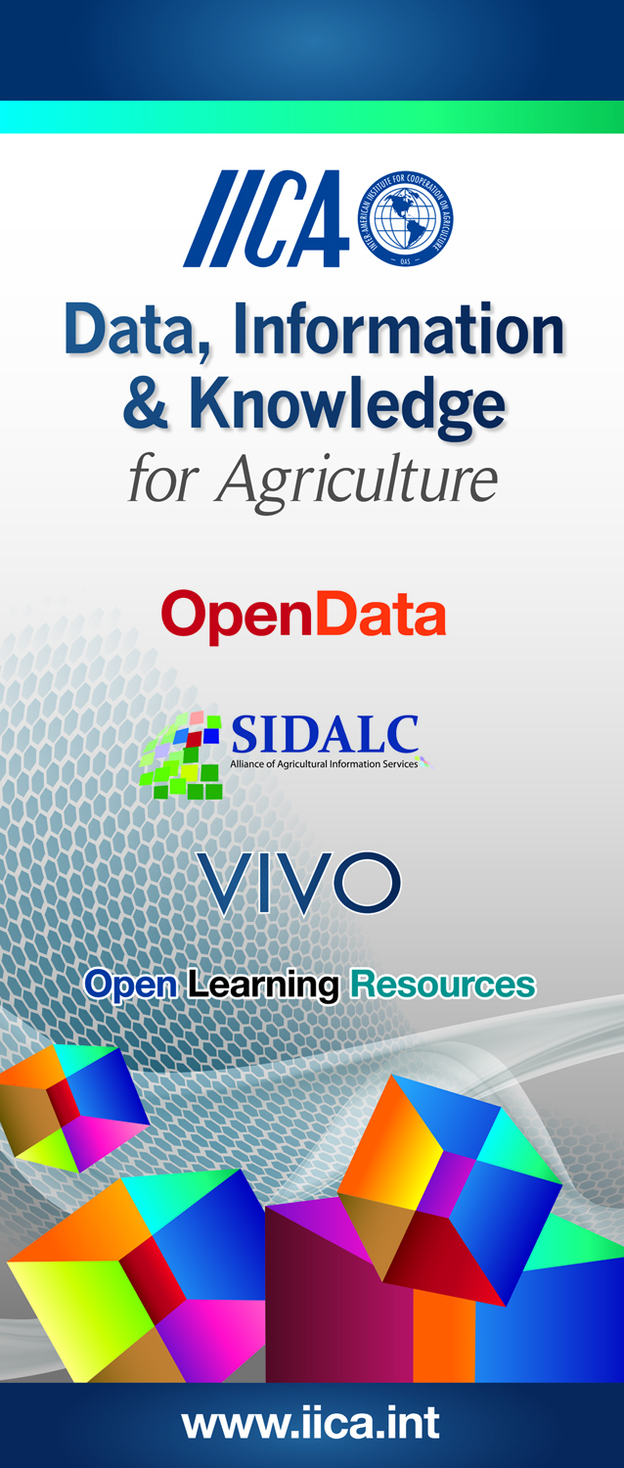
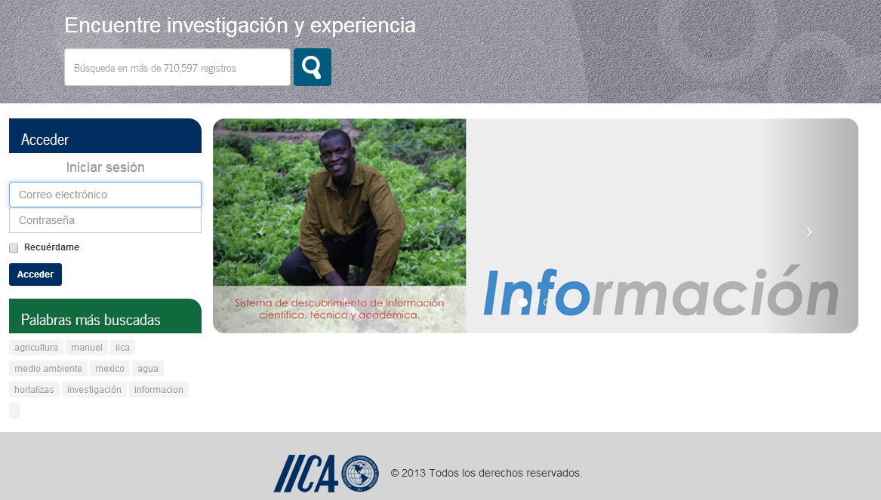
A larger effort
AGRI-D will be a discovery tool or hub for agricultural knowledge, data and information in the Americas
Agri-D
www.agri-d.net

Slide 18
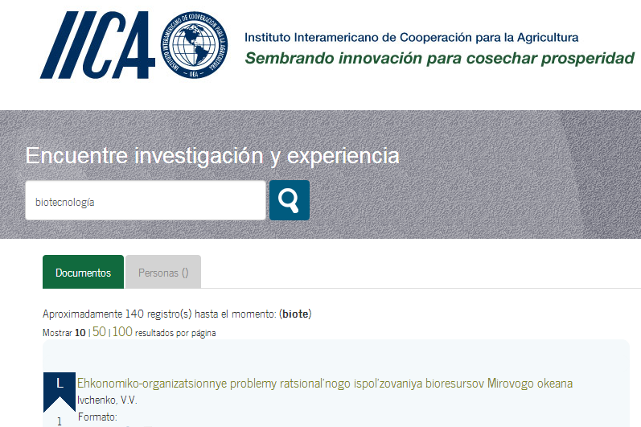
PEOPLE
DOCUMENTS

Slide 19
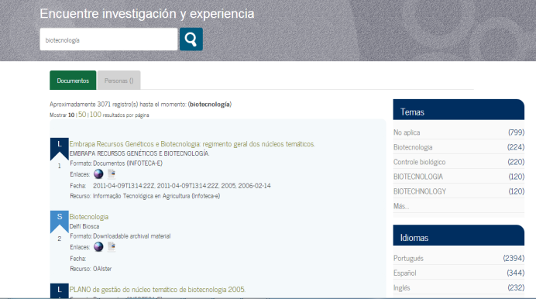
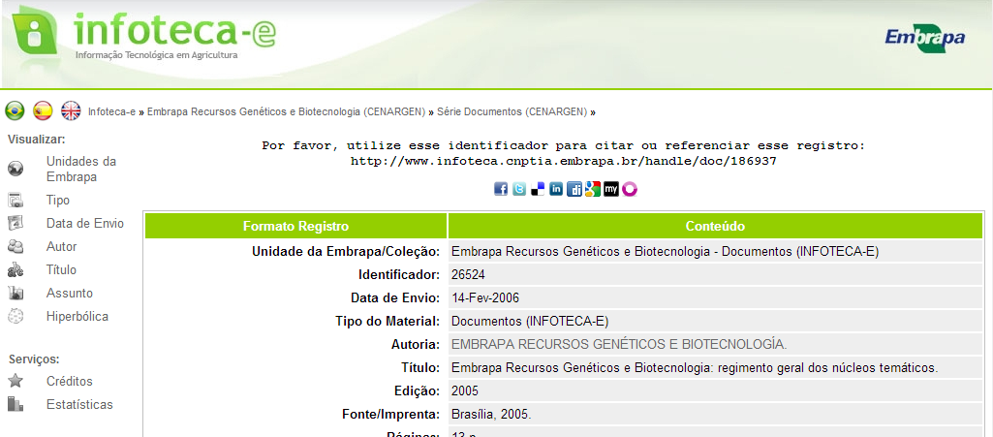
Linking the dots: Documents
Agri-D
Library catalogs
Institutional repositories
OJS
….

Slide 20
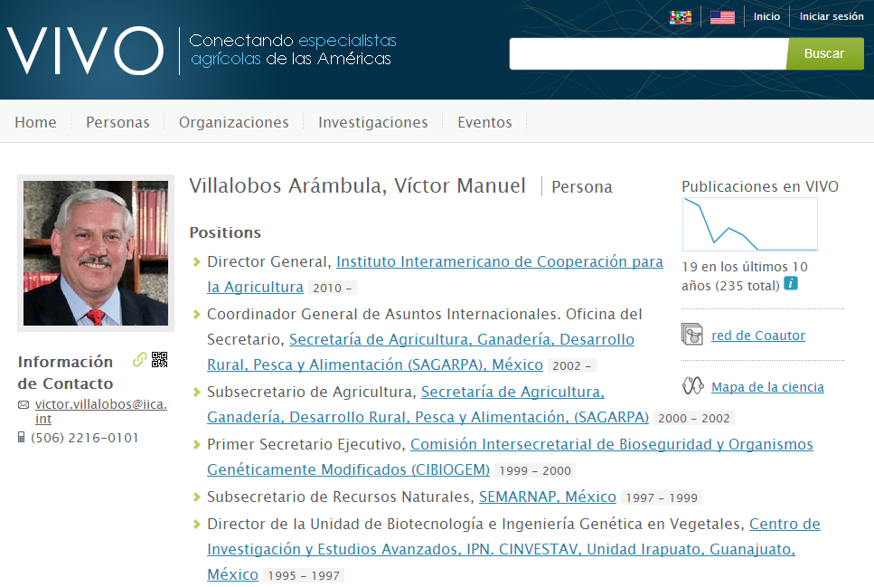
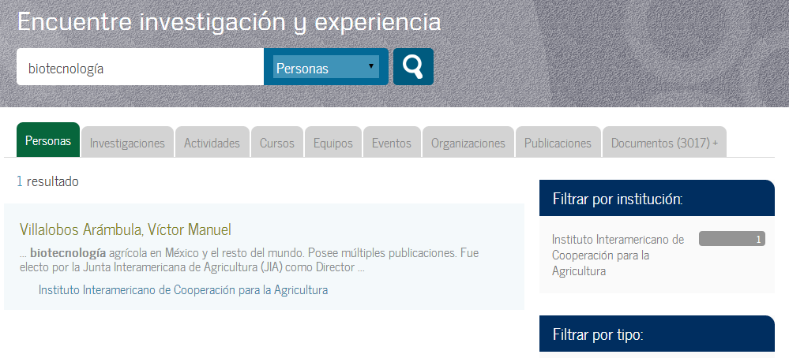
Linking the dots: People
Agri-D
VIVO
….

Slide 21

Thanks for your attention federico.sancho@iica.int

